Slide 1

Synthetic Biology Open Language
Presenter: Jacob Beal (BBN Technologies)
Introductory SBOL Workshop, August 11th, 2017
Pittsburgh, PA
Editors: Robert Sidney Cox III (Kobe University), Raik Gruenberg (KAUST), James McLaughlin (Newcastle University), Tramy Nguyen (University of Utah), Nicholas Roehner (Boston University)
Chair: Anil Wipat (Newcastle University)
SBOL Development Group: 120 members from more than 60 academic and industrial organizations.

Slide 2
Standards are a foundational principle of synthetic biology
Three foundational principles of synthetic biology based on engineering practice (Endy 2005):
Standardization
Abstraction
Decoupling
Synthetic biology was born with the broad goal of engineering or 'wiring' biological circuitry — be it genetic, protein, viral, pathway or genomic — for manifesting logical forms of cellular control. (Collins 2010)
Biology has long surpassed its mainly descriptive stage, and the questions now asked are increasingly amenable to experimental approaches and theoretical concepts taken from the physical and engineering sciences. (Scwhille 2011)
Notes:
The last few slides have introduced the vocabulary of synthetic biology and highlighted engineering principles. Let’s review some of these principles. Ask class, what are other engineering principles? CAD, mathematical modeling, simulation, Modularity
Decoupling: you don’t have to build it to understand how it works, mention R&D costs in biotech vs classical engineering
Composition use the metaphor of a wrench and bolt

Slide 3
What is SBOL?
SBOL actually consists of 2 standards:
SBOL Data model
a formalized representation of data objects
SBOL Visual
a standardized set of schematic symbols for genetic design
To guarantee interoperability between tools and standards, SBOL leverages ontologies, such as the Sequence Ontology (SO), Systems Biology Ontology (SBO).

Slide 4
Milestones in the history of SBOL
Kick-off at a computational synthetic biology workshop at the University of Washington
Apr, 2008
The SBOL Developers Group was officially established with adoption of formal rules of governance and election of editors
Jun, 2011
First version of the SBOL data model was released
(BB FRFC 84)
Sep, 2011
First version of the SBOL Visual standard was released
(BBF RFC 93)
Mar, 2013
SBOL Version 2.0 was officially released
(BBF RFC 108)
Jul, 2015
Jun, 2016
ACS Synthetic Biology adopts SBOL as publication standard
Notes:
The last few slides have introduced the vocabulary of synthetic biology and highlighted engineering principles. Let’s review some of these principles. Ask class, what are other engineering principles? CAD, mathematical modeling, simulation, Modularity
Decoupling: you don’t have to build it to understand how it works, mention R&D costs in biotech vs classical engineering
Composition use the metaphor of a wrench and bolt

Slide 5
Evolution of standards for Bioinformatics
FASTA
GenBank
SBOL 1.1
SBOL 2.0
ACTGTGCCGTTAAACGTGATTAAATCCGTACTGATAT…
Raw sequence information
TetR
GFP
Contains sequence features
pTet
aTc detector
GFP reporter
Represents sequence features hierarchically
TetR
GFP
pTet
aTc
Represents additional molecule types
Represents modules with inputs and outputs
TetR
TetR
GFP
TetR
GFP
pTet

Slide 6
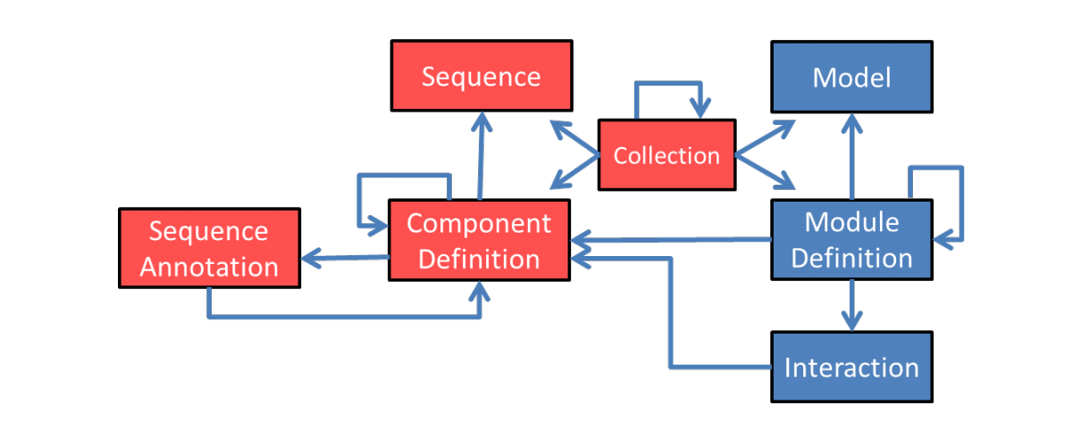
SBOL Data Model
SBOL v2.0.0
SBOL v1.1.0

Slide 7
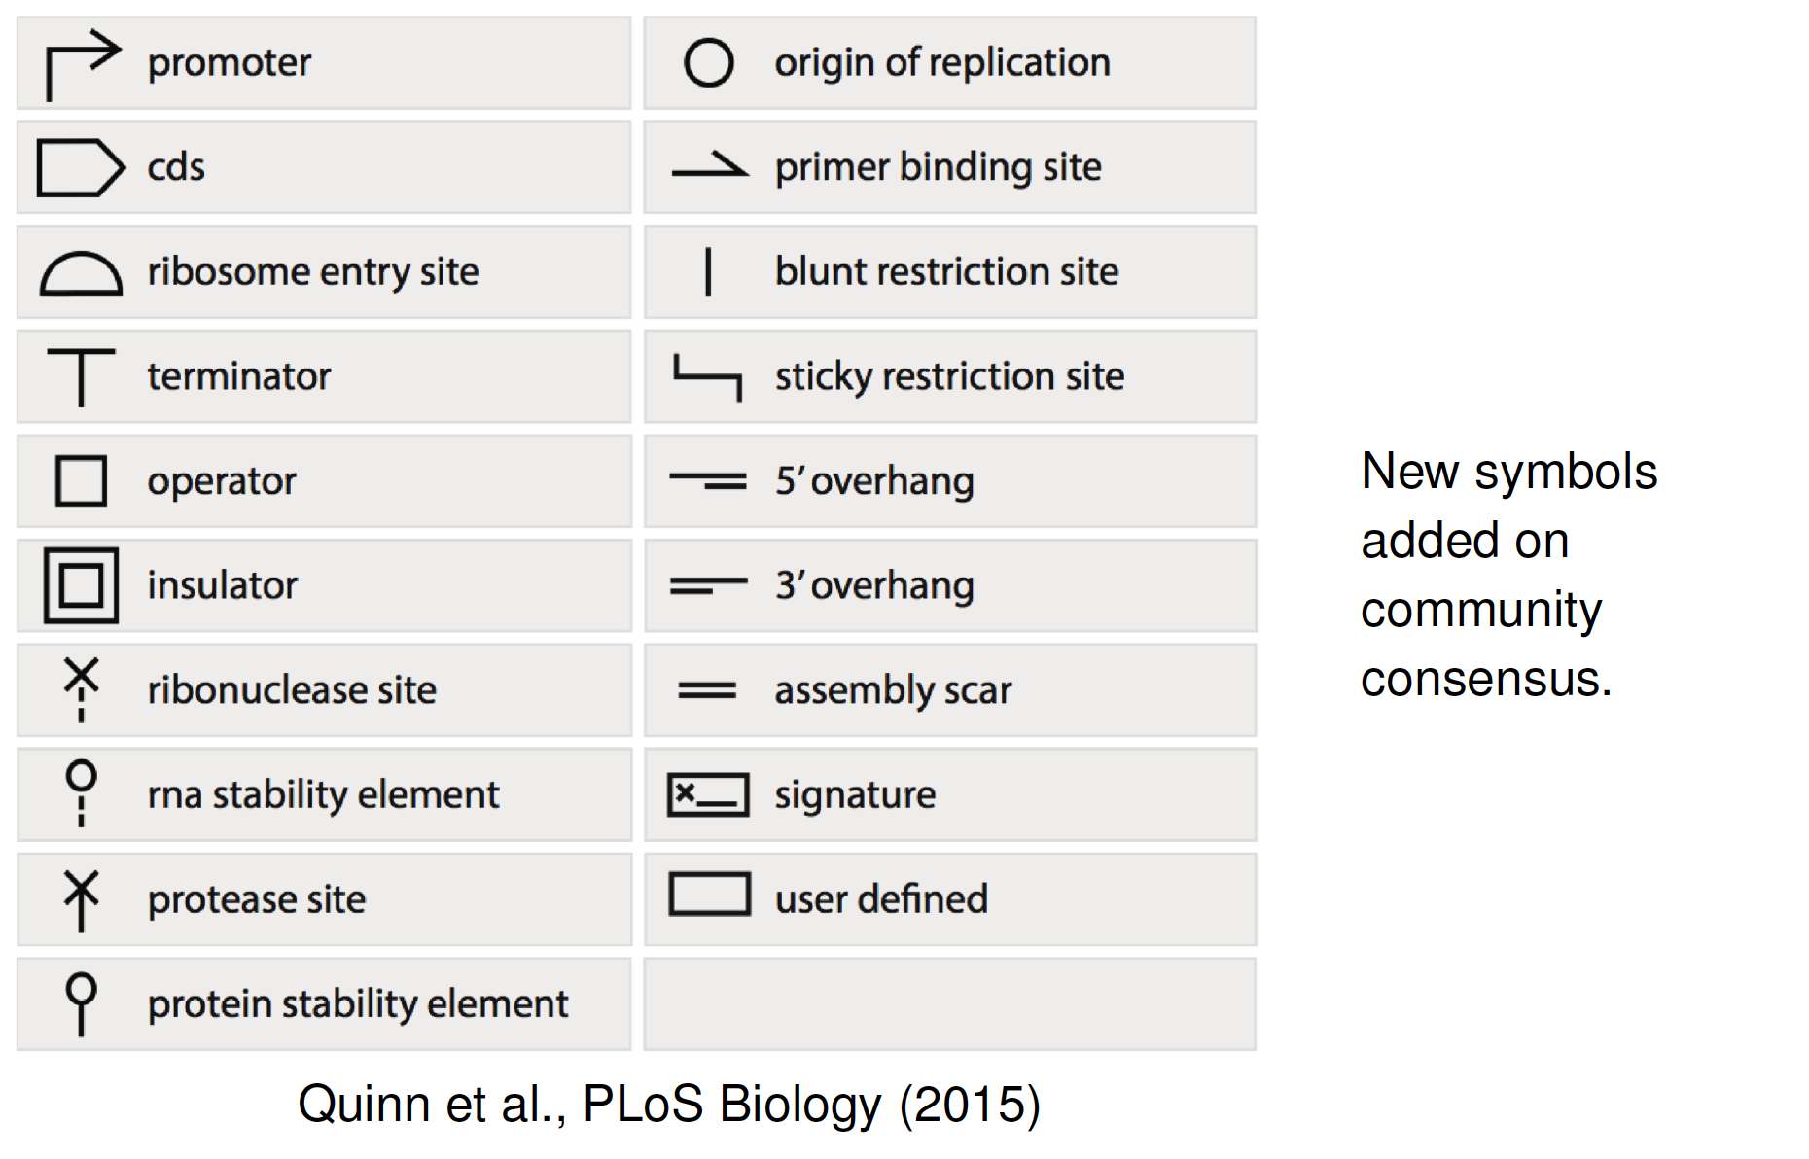
SBOL Visual v1.0.0

Slide 8
Relation between SBOL Visual and SBOL Data Model
Notes:
The last few slides have introduced the vocabulary of synthetic biology and highlighted engineering principles. Let’s review some of these principles. Ask class, what are other engineering principles? CAD, mathematical modeling, simulation, Modularity
Decoupling: you don’t have to build it to understand how it works, mention R&D costs in biotech vs classical engineering
Composition use the metaphor of a wrench and bolt

Slide 9


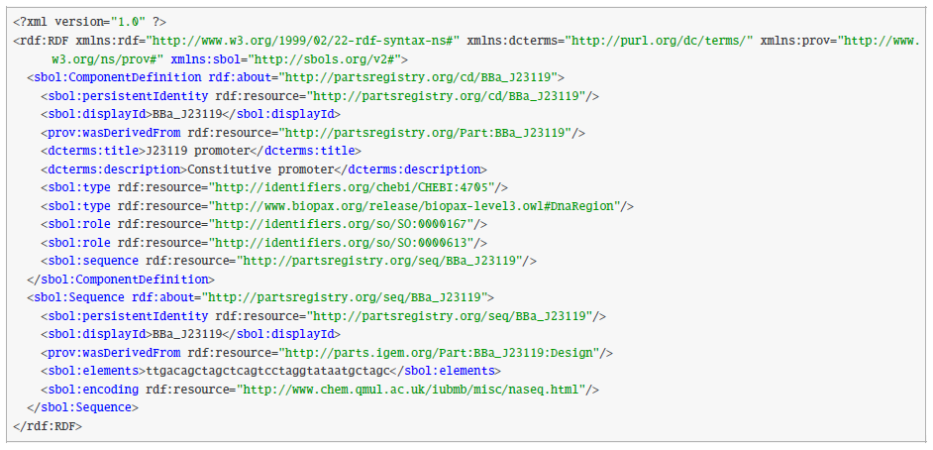
SBOL is serialized in RDF/XML Format
XML allows data to be structured in hierarchical trees, is well-supported and well-understood by software developers
RDF makes data integration across networks easier

Slide 10


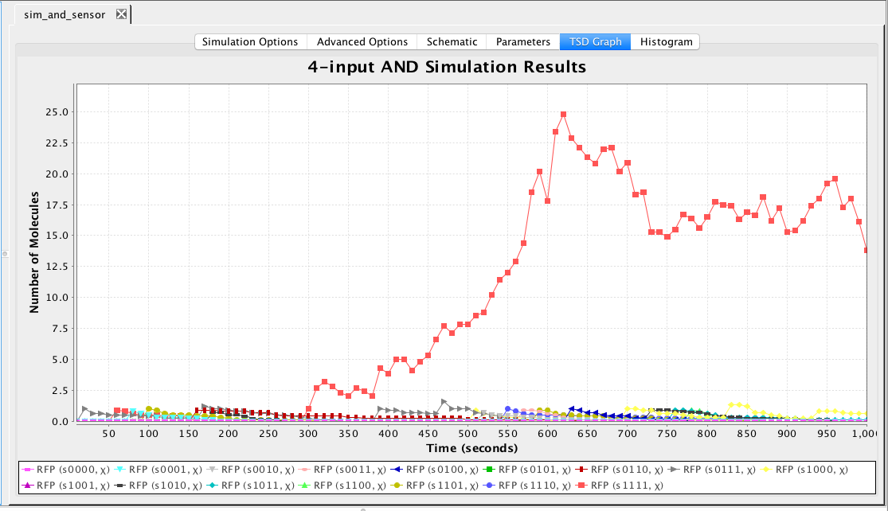




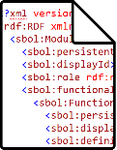


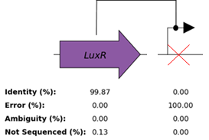

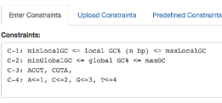
SBOL helps synthetic biologists to collaborate across different stages of (automation-assisted) workflows
Computer Aided
Engineering (CAE)
Publication
Parts Repositories
SBOL
Computer Aided
Design (CAD)
Quality Control (QC)
Computer Aided Manufacturing (CAM)
Notes:
Computer-aided Engineering (CAE) is the use of simulation tools for forward engineering of products. For example CAE is often used for design of electronic circuits like radios and microwaves. SBOL enables forward-design of genetic, metabolic, and protein networks using components obtained from parts repositories. SBOL is used to represent the qualitative structure and function of these networks. SBOL is interconvertible with Systems Biology Markup Language (SBML) for biosimulation.
Computer-aided Design (CAD) is often used by engineers to represent 2D and 3D objects like mechanical components.
CAD for synthetic biology is a relatively new application that involves reasoning about the structure of genetic information. SBOL supports design abstraction, modularity, and hierarchy.
Reproducibility is still a major challenge for synthetic biologists. In many cases the full sequence of a genetic circuit is not even included in scientific publications. The SBOL community is working closely with publications like ACS Synthetic Biology to encourage authors submit designs / sequences / strains to repositories along with their manuscripts.
Failure is the norm in synthetic biology. Often many variations of a design must be built and tested before a successful design is found. Failure Modes and Effects Analysis (FMEA) are methodologies that help engineers learn from failure, continuously improve, and construct complex systems. SBOL enables novel Quality Control (QC) visualization tools and FMEA analysis for mutations, assembly errors, and their effect on circuit function.
SBOL Stack and VirtualParts repositories can be accessed through the cloud using a Web interface, a RESTful API, or SPARQL queries.
The Joint Bioenergy Institute’s public repository (JBEIR) supports uploading and downloading of SBOL
Inventories of well-defined bioparts are necessary to construct synthetic systems of interesting complexity. The DICOM-SB standard enables measurement data to be stored as standard data sheets.
Computer-aided manufacturing (CAM) is often a scripted procedure of steps like rough cutting and finishing a manufactured good. In synthetic biology CAM tools help refine DNA sequences to meet manufacturing constraints, such as %GC or optimal codon usage. SBOL enables annotation of optimization targets and communication of designs to DNA synthesis and construction vendors

Slide 11
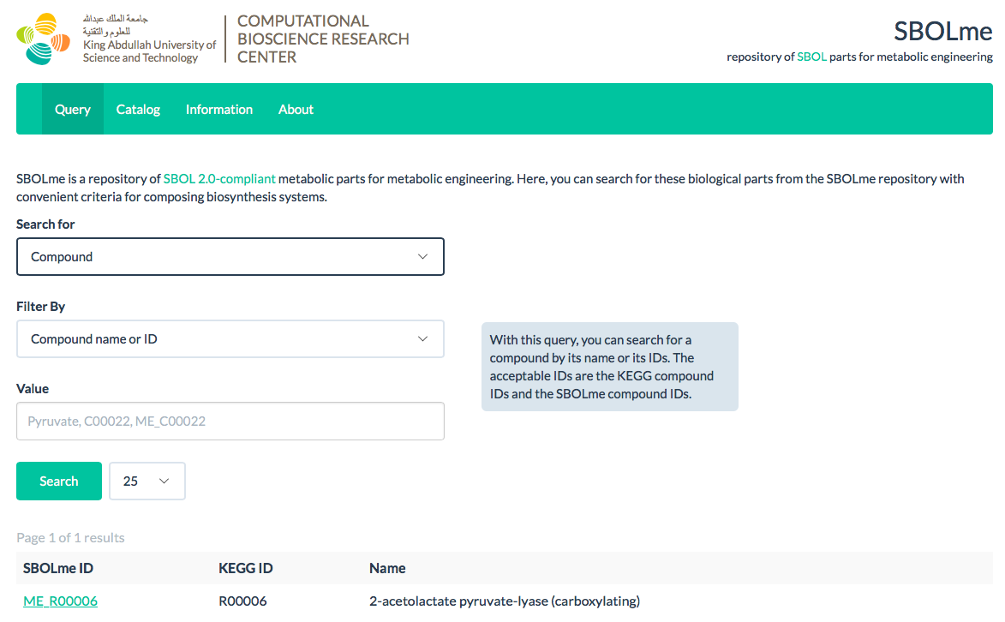
Data Repositories: SBOLme
Kuwahara et al., ACS Synthetic Biology (2017) Includes 28,437 chemical compounds, 6,883 enzyme classes, 9,909 metabolic reactions, and 3,173,238 proteins from 3,908 organisms.

Slide 12
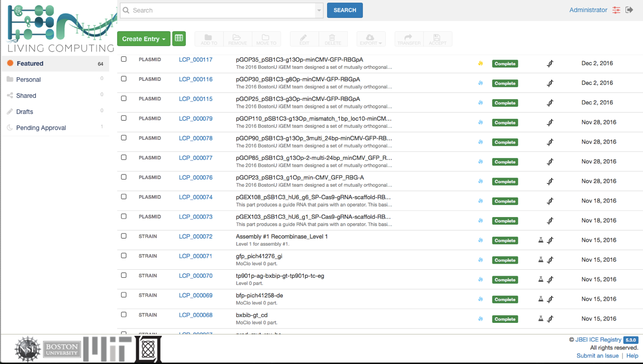
Data Repositories: ICE
Ham et al., Nucleic Acid Research (2012)

Slide 13
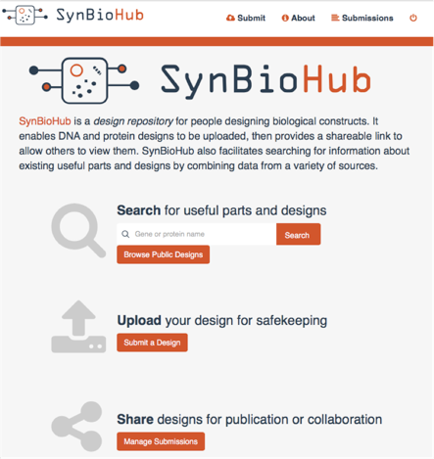


Data Repositories: SynBioHub
James McLauglin
Anil Wipat
Zach Zundel
Chris Myers

Slide 14
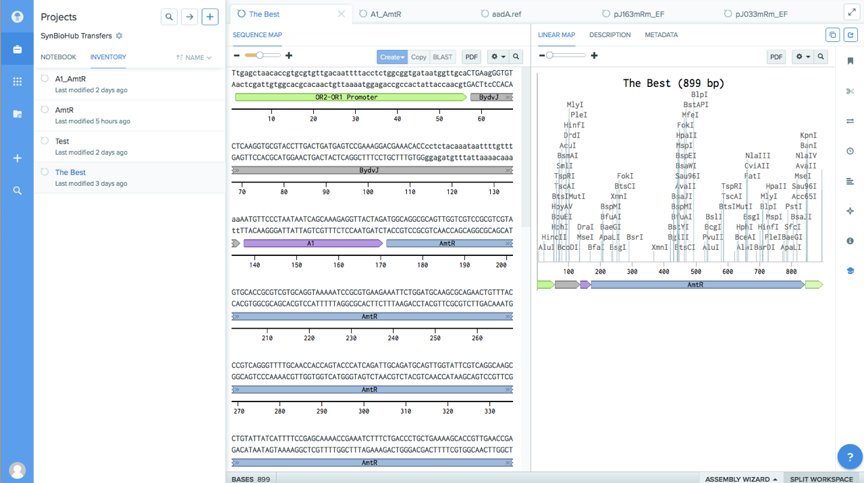
Sequence Editor: Benchling

Slide 15
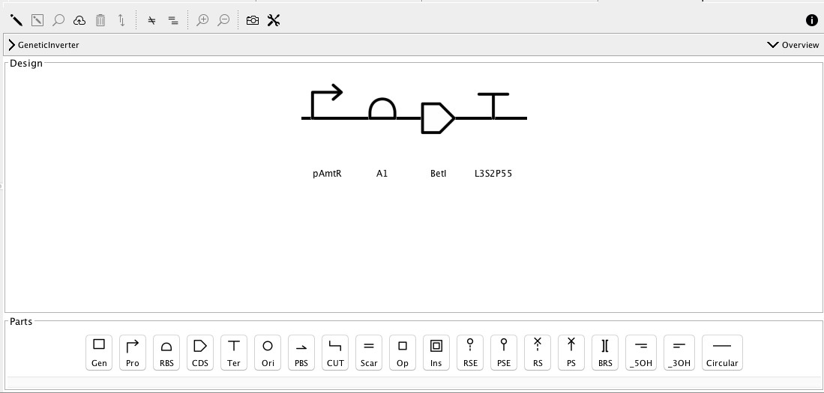
Sequence Editor: SBOL Designer
Zhang et al., ACS Synthetic Biology (2017)
Other sequence editors that support SBOL: DeviceEditor, J5, VectorEditor (JBEI), DNAPlotLib (MIT/UW/Bristol), Eugene (Boston), GenoCAD (VBI), BOOST (JGI), etc.

Slide 16
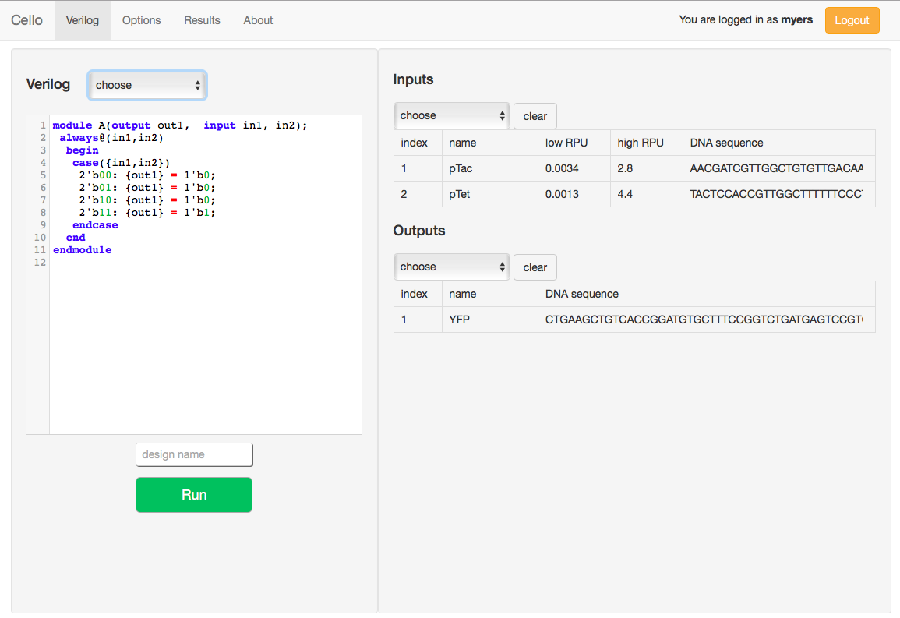
Circuit Design Tools: Cello
Nielsen et al., Science (2016)

Slide 17
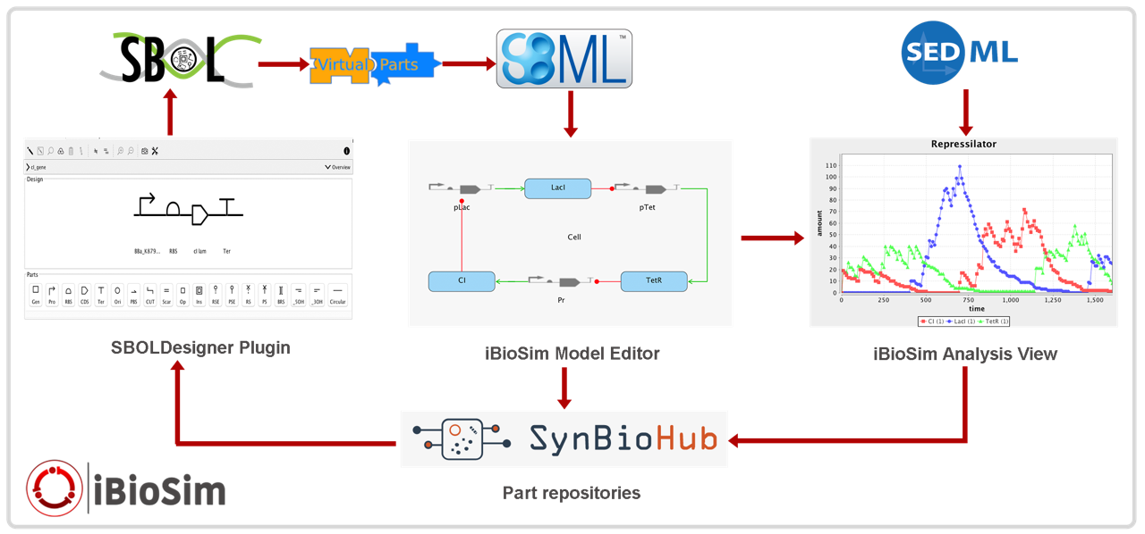
Circuit Design Tools: iBioSim
Madsen et al., IEEE Design & Test (2012)

Slide 18
Open Source Libraries
Software libraries which import and export SBOL files are freely available at the Synthetic Biology Data Exchange on GitHub under the Apache 2.0 license. Libraries are implemented in:
Java
Javascript
C/C++
Python
Developer support includes (see http://sbolstandard.org/software/libsbol)
Online documentation
Getting started tutorials
Sample projects
Code examples

Slide 19
ACS Synthetic Biology has officially adopted SBOL as publication standard
SBOL Visual is the recommended graphical notation for depicting genetic constructs
SBOL 2.0 Data Model is the preferred format for nucleic acid sequences.
Manuscript submission, review, and production process is linked to SBOL-enabled repositories
Joint Bioenergy Institute (JBEI) has set up the initial repository.
Read all about it in the ACS Synthetic Biology viewpoint article: Improving Synthetic Biology Communication: Recommended Practices for Visual Depiction and Digital Submission of Genetic Designs, or listen to the interview with Jake Beal and Nathan Hillson.

Slide 20
Representing Designs in SBOL
SBOL v2.0.0
SBOL v1.1.0

Slide 21
ComponentDefinition
ComponentDefinition
identity: iGEM#I13504
name: “iGEM 2016 interlab reporter”
description: “GFP expression cassette used for 2016 iGEM interlab”
type: biopax#DnaRegion
role: SO:0000804 (Engineered Region)

Slide 22
Component
CD: iGEM#I13504
component
Component
Component
Component
definition
definition
definition
ComponentDefinition
identity: iGEM#B0034
name: RBS (Elowitz 1999)
type: biopax#DnaRegion
role: SO:0000139 (Ribosome Entry Site)
ComponentDefinition
identity: iGEM#E0040
name: GFP
type: biopax#DnaRegion
role: SO:0000316 (CDS)
ComponentDefinition
identity: iGEM#B0015
name: double terminator
type: biopax#DnaRegion
role: SO:0000141 (Terminator)

Slide 23
SequenceConstraint
CD: iGEM#I13504
sequenceConstraint
component
sequenceConstraint
Component
Component
Component
definition
definition
definition
subject
object
subject
object
SequenceConstraint
restriction: sbol#precedes
SequenceConstraint
restriction: sbol#precedes
CD: iGEM#B0034
CD: iGEM#E0040
CD: iGEM#B0015

Slide 24
Sequence, SequenceAnnotation
CD: iGEM#I13504
sequence
sequenceAnnotation
component
Sequence
encoding: iupac#naseq
elements: aaagagga…
Component
definition
component
SequenceAnnotation
location
CD: iGEM#B0015
SequenceAnnotation
role: SO:0001953 (Assembly Scar)
Range
start: 746
end: 875
sequence
location
Sequence
encoding: iupac#naseq
elements: ccaggcatca…
Range
start: 738
end: 745

Slide 25
Reusing Components
CD: iGEM#interlab16device1
CD: iGEM#interlab16device2
sequenceConstraint
component
sequenceConstraint
component
SC: precedes
SC: precedes
subject
object
object
subject
Component
Component
Component
Component
definition
definition
definition
definition
CD: iGEM#J23101
CD: iGEM#I13504
CD: iGEM#J23106

Slide 26
Collection
Collection:
identity: iGEM#interlab16
name: “iGEM 2016 interlab parts”
description: “Collection of parts used for 2016 iGEM interlab”
CD: iGEM#interlab16device1
member
CD: iGEM#interlab16device2
CD: iGEM#interlab16device3
CD: iGEM#interlab16positiveControl
CD: iGEM#interlab16negativeControl

Slide 27
ModuleDefinition
Model:
identity: my-iBioSim-ODE
source: https://synbiohub…
language: edam#2585 (SBML)
framework: SBO:0000062 (continuous)
ModuleDefinition: iGEM#M-I13504
GFP
model
functionalComponent
interaction
Interaction:
type: SBO:0000589 (genetic production)
Functional Component
participation
Functional Component
definition
Participation:
role: SBO:0000645 (template)
Participation:
role: SBO:0000011 (product)
definition
participant
participant
CD: iGEM#I13504
CD: GFP
type: biopax#Protein
GFP

Slide 28
Composing Modules
ModuleDefinition: AraInducedGFP
module
Ara
GFP
module
functionalComponent
Module
definition
Functional Component
definition
Module
definition
ModuleDefinition: AraInduction
ModuleDefinition: iGEM#M-I13504
Ara
GFP
functionalComponent
functionalComponent
Functional Component
CD: pBAD-GFP
Functional Component
definition
definition
CD: iGEM#I13453
component
CD: iGEM#I13504
definition
definition
Component
Component

Slide 29
Next up: libraries & hands-on experience

Slide 30


Acknowledgments
SBOLDesigner

